Slide 1

The Program, Implementation, and Features

Slide 2
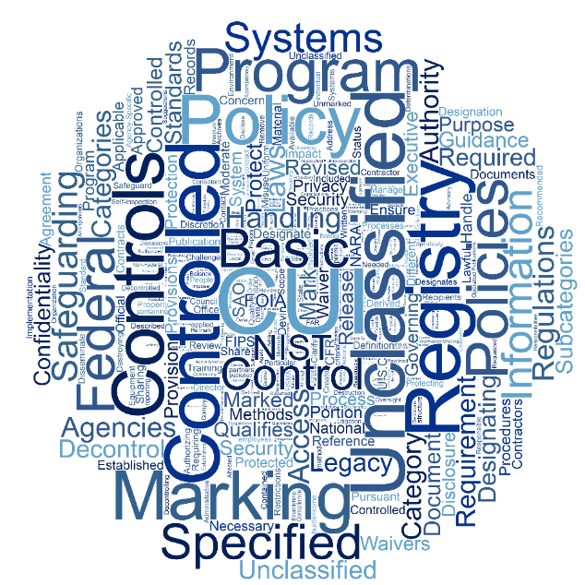
Outline
Why protect CUI?
Existing Agency Policy and Procedure
Laws, Regulations, and Government-wide policies (LRGWP)
An Information Security Reform
Features

Slide 3
What is Controlled Unclassified Information (CUI)?
CUI is information that needs protection. Laws, Regulations, or Government wide policies call for this information to be protected.
  The CUI Registry provides information on the specific categories of information that the Executive branch protects. The CUI Registry can be found at:
  https://www.archives.gov/cui

Slide 4

CUI includes, but is not limited to:
  Financial
  Intelligence
  Privilege
  Unclassified Nuclear
  Procurement and Acquisition
  Privacy (including Health)
  Tax
  Law Enforcement
  Critical Infrastructure
  Export Control

Slide 5
Why protect CUI?
  The loss or improper safeguarding of CUI could be expected to have a serious adverse effect on organizational operations, organizational assets, or individuals.
    degradation in mission capability;
    damage to organizational assets;
    financial loss; or
    harm to individuals

Slide 6
LRGWP
Laws, Regulations, and Government-wide policies (LRGWP) identified what to protect but failed to say how.
Agencies took steps to define protection through the issuance of policy and procedure
  Lack of oversight over sensitive information programs

Slide 7

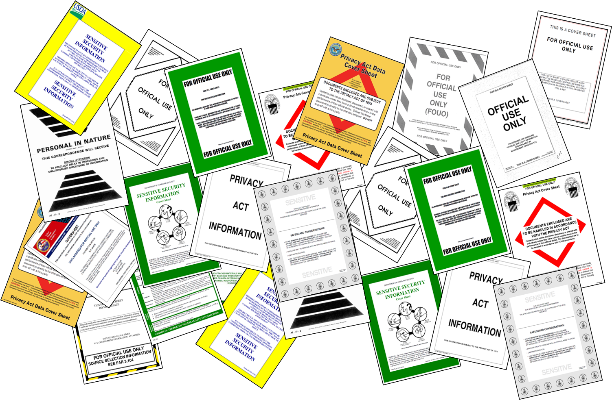
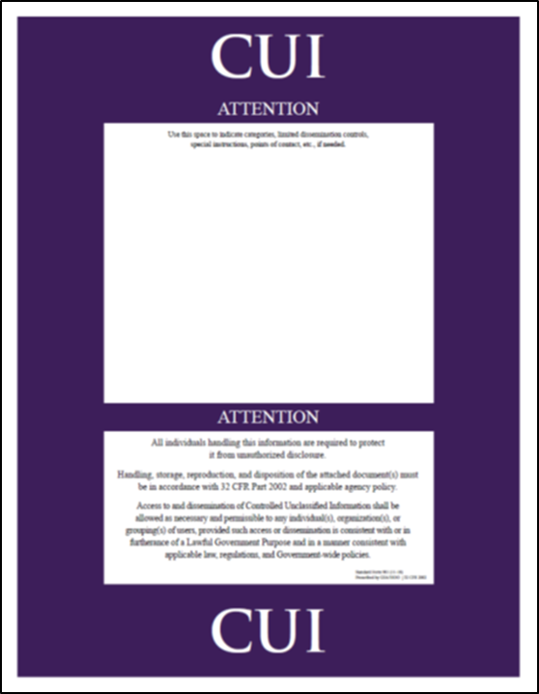
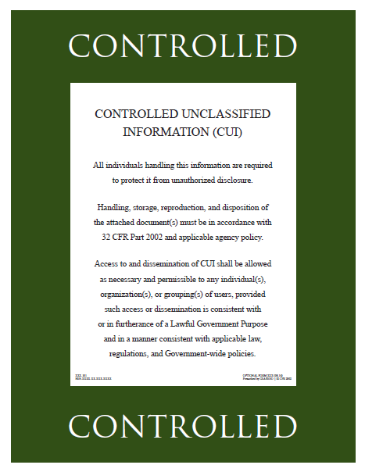
Information Security Reform
Clarifies what to protect
Defines safeguarding
Reinforces existing LRGWP
Promotes authorized information sharing

Slide 8
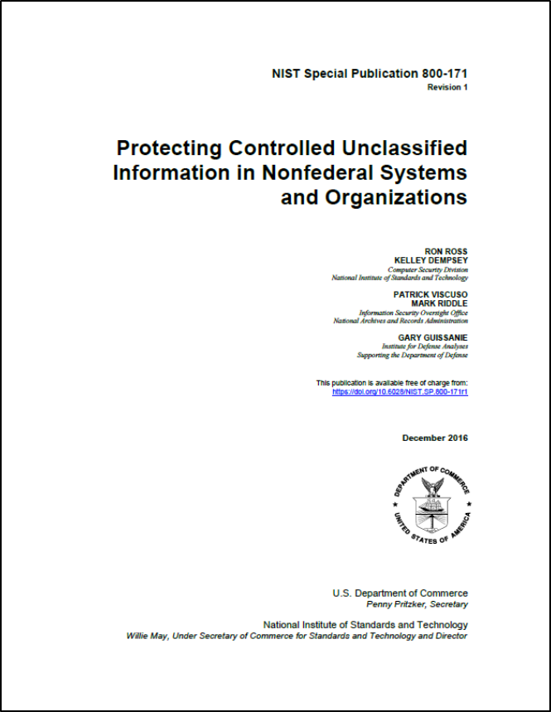
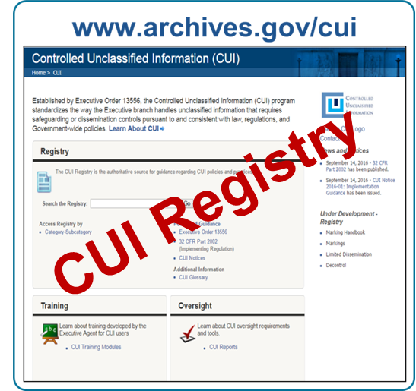
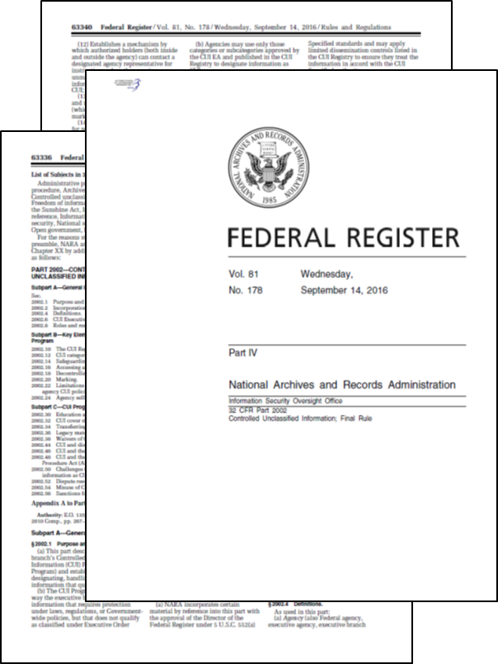
What we protect and How we protect it
32 CFR 2002

Slide 9
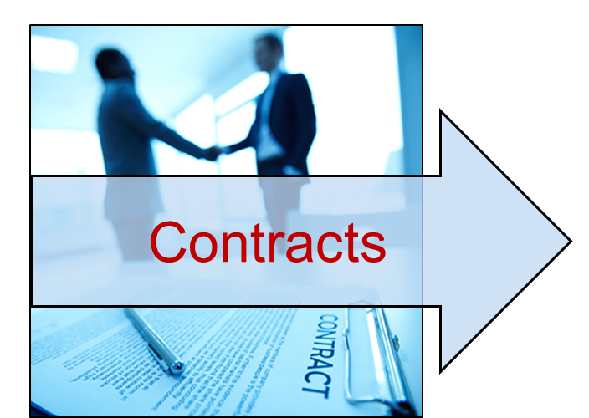
Federal Acquisition Regulation (FY19)
“This FAR rule is necessary to ensure uniform implementation of the requirements of the CUI program in contracts across the government, thereby avoiding potentially inconsistent agency-level action.” –Unified Agenda

Slide 10

Implementation
Implementation has begun
  Program officials, resources, policy, training, systems, contracts, oversight
CUI practices and Legacy practices will exist at the same time.

Slide 11
CUI Basic and CUI Specified
CUI Specified
(Requires unique markings)
Laws, Regulations, or Government-wide policies require specific protections. For example:
Unique markings
Enhanced physical safeguards
Limits on who can access the information
CUI Basic
Laws, Regulations, or Government-wide policies DO NOT require specific protections.
Notes:
Before Marking CUI, it is important to understand that there are two types of CUI,
CUI Specified is sensitive information for which laws, regulations and Government-wide polices – or authorities - call for specific protections.
For CUI Basic the authorities do not.
CUI Specified must be marked in a different way.

Slide 12
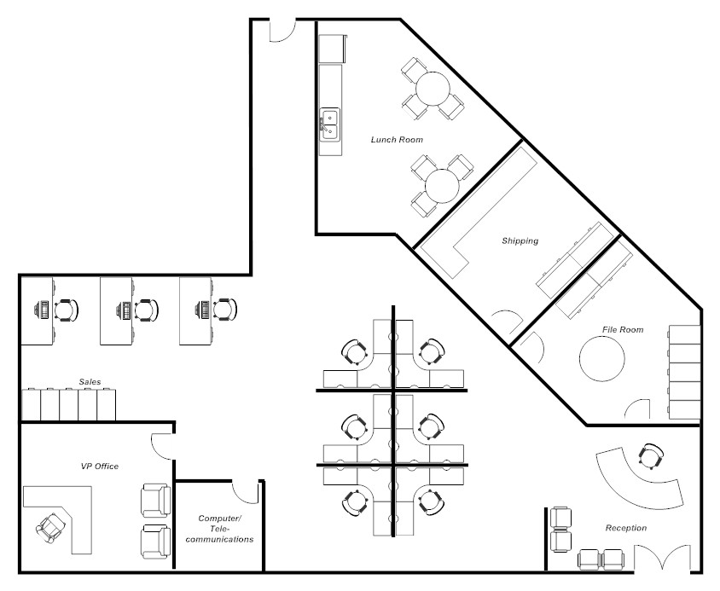
Controlled Environments
Controlled environment is any area or space an authorized holder deems to have adequate physical or procedural controls (e.g., barriers and managed access controls) for protecting CUI from unauthorized access or disclosure.
Reception Area used to control access to workspace.

Slide 13
Assessing physical environments
Going beyond gates, guns, and guards: Internal security
  Who works in the space?
  Who has access to the space during and after business hours?
  Do individual workspaces (cubes & offices) have adequate safeguards to prevent access (locking cabinets, drawers, or overhead bins)?
  Suitable for sensitive discussions?

Slide 14
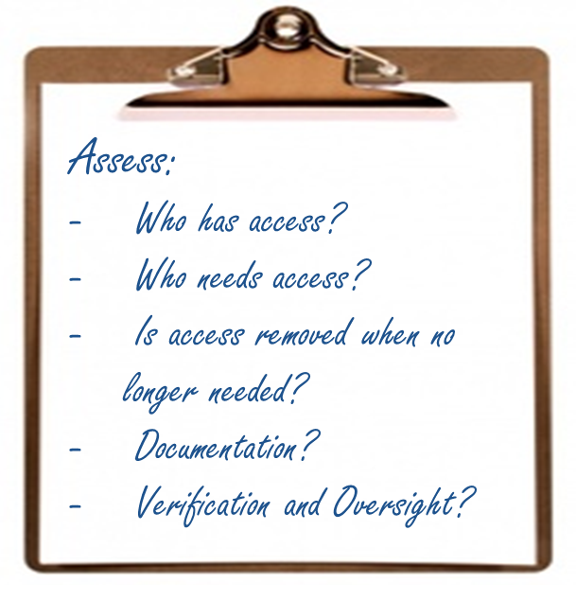
Assessing electronic Environments
Limit and control access to CUI within the workforce by establishing electronic barriers.

Slide 15
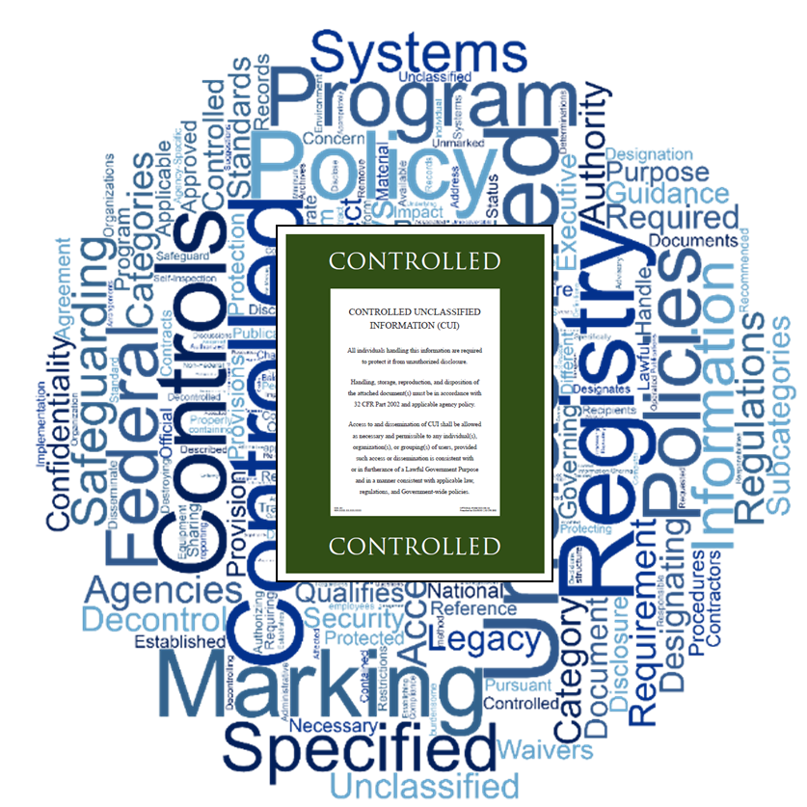

Other Considerations
Personal Devices
Telework
Bring/Use your own device
USB Drives
Travel
Separation and transfers
Insider Threats

Slide 16

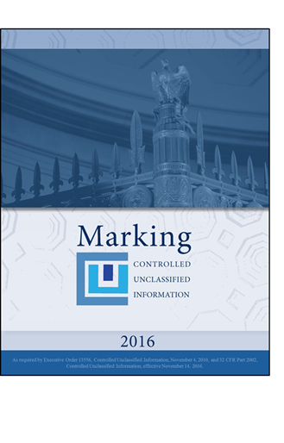
Products to assist
Training Videos

Slide 17
CUI Overview Video (11 Minutes)

Slide 18

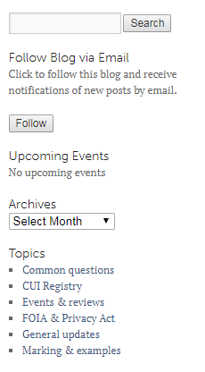
CUI Blog

Slide 19

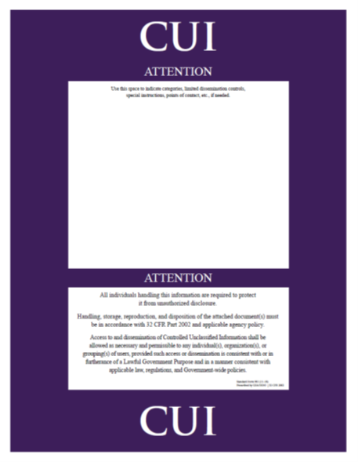
Questions?

